Slide 1


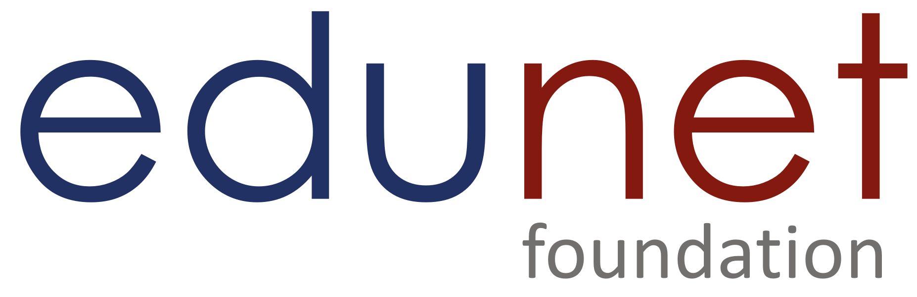

NEXT GEN EMPLOYABILITY PROGRAM
Creating a future-ready workforce
Team Members
College Name
Student Name : Jeevanantham S
Student ID : aut2271100009
Info Institute of Engineering

Slide 2
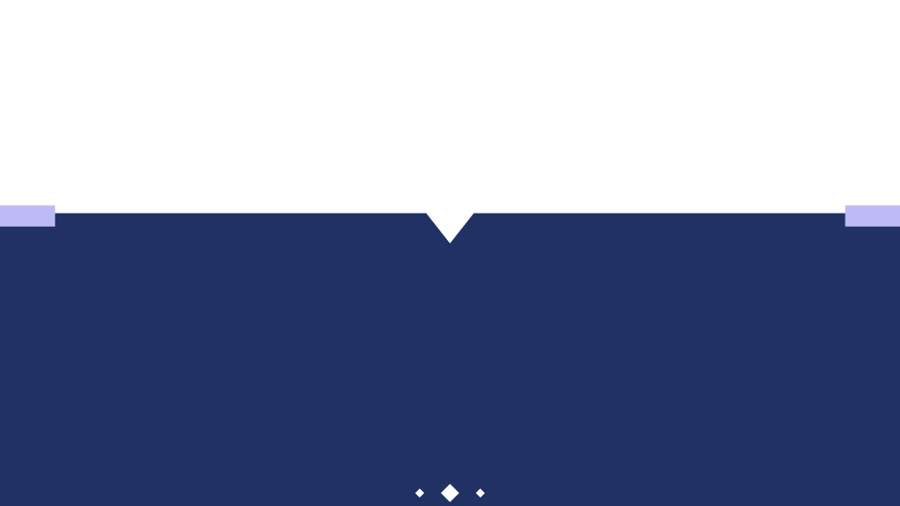
CAPSTONE PROJECT SHOWCASE
Project Title
Notes Sharing Web Application using Django Framework
Abstract | Problem Statement | Project Overview | Proposed Solution | Technology Used | Modelling & Results | Conclusion

Slide 3
Abstract
ShareNote is a collaborative notes sharing platform built on the Django framework, designed to streamline the sharing and collaboration process among users. With secure user authentication and authorization, users can register, log in, and manage their accounts securely. The platform offers intuitive note creation and organization features, allowing users to categorize notes into folders or tag them for easy retrieval. Real-time collaboration enables multiple users to work simultaneously on the same note, with changes synchronized instantly. Version control ensures data integrity by tracking changes and revisions, while granular sharing permissions allow users to control access to their notes. Powerful search and filtering capabilities enable users to quickly find relevant information, while notifications and an activity feed keep them informed about recent interactions and collaborations.
Source :

Slide 4
Problem Statement
Developing a collaborative notes sharing application using the Django framework addresses the pressing need for efficient digital collaboration tools in both educational and professional settings. Current solutions often lack necessary features and security, hindering effective note sharing and collaboration. This project aims to create a web-based application that allows users to seamlessly create, organize, share, and collaborate on notes in real-time. Key requirements include robust user authentication, comprehensive note management features, real-time collaborative editing capabilities, version control functionality, granular sharing permissions, and advanced search and filtering options. By fulfilling these requirements, the application will provide users with a secure, intuitive, and customizable platform for managing notes and facilitating teamwork. Ultimately, this project seeks to enhance productivity, streamline collaboration processes, and promote knowledge sharing among individuals and teams across various domains.
Source :

Slide 5
Project Overview
Our project aims to develop a notes sharing application using the Django framework. Leveraging Django's powerful features, we intend to create a user-friendly platform that enables seamless collaboration and sharing of notes among users. The application will include essential functionalities such as user authentication, note creation and organization, real-time collaborative editing, version control, sharing permissions, search and filtering, notifications, and activity tracking. With an intuitive interface and advanced features, our application will cater to the needs of both individuals and teams in various settings, including education, business, and personal use. By prioritizing scalability, security, and usability, we aim to deliver a reliable solution for efficient notes management and collaboration. Through this project, we seek to enhance productivity, streamline communication, and foster knowledge sharing among users.
Source :

Slide 6
Proposed Solution
Authentication System for User Management
Version Control Features
Filtering Options
Security
Usability
Collaboration
Centralization
Source :

Slide 7

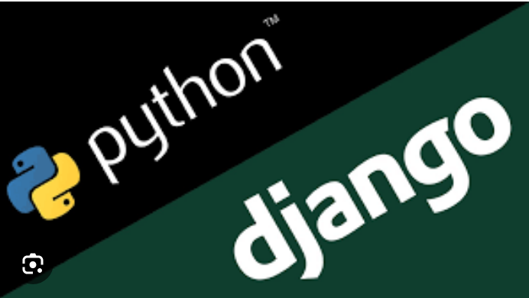
Technology Used
Front-end
Back-end
Source :

Slide 8
Modelling & Results
The ShareNote application utilizes a robust data model to manage user accounts, notes, collaborations, and permissions. The model architecture includes entities such as User, Note, Collaboration, Permission, and Tag, implemented using Django's built-in ORM (Object-Relational Mapping) capabilities. Each user has a unique profile with authentication credentials and access permissions. Collaborations establish relationships between users for real-time editing and sharing of notes, while permissions govern access rights for shared content.
In testing, ShareNote exhibited efficient performance, handling concurrent user interactions and maintaining data consistency during collaborative editing sessions The model architecture facilitated easy customization and extension of features, ensuring adaptability to evolving user requirements. Overall, ShareNote robust modeling approach contributed to its success in providing a reliable and scalable platform for collaborative notes sharing.
Source :

Slide 9
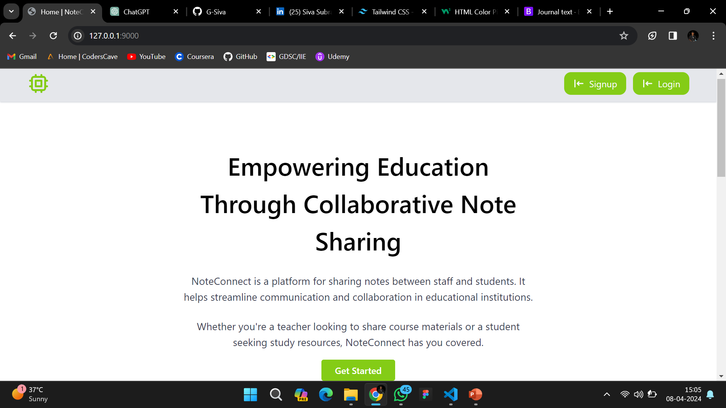
Home-page

Slide 10
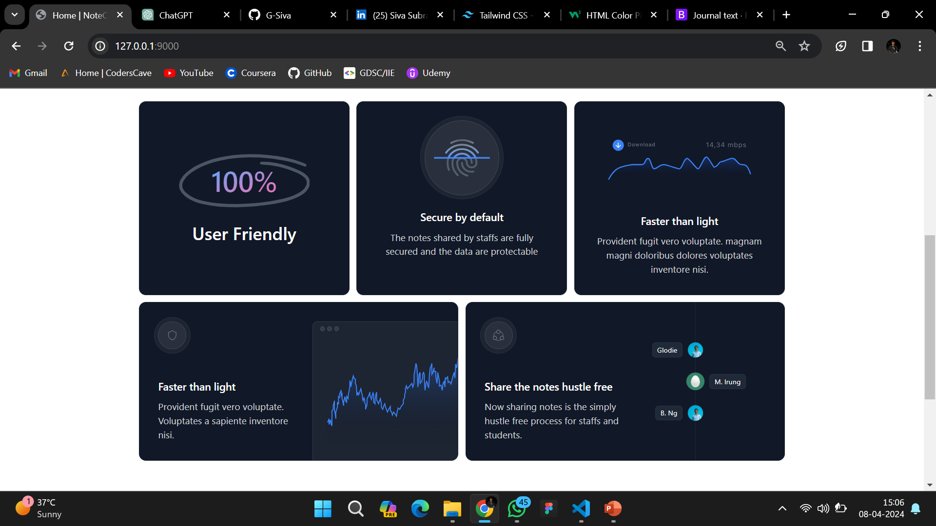
About-Us-Page

Slide 11
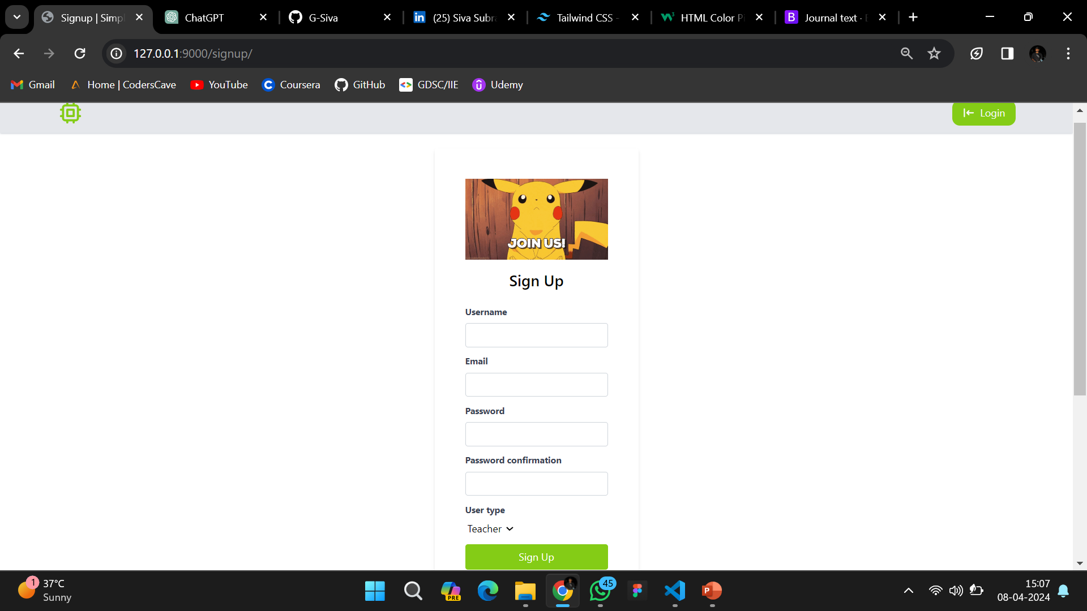
Sign up-Page

Slide 12
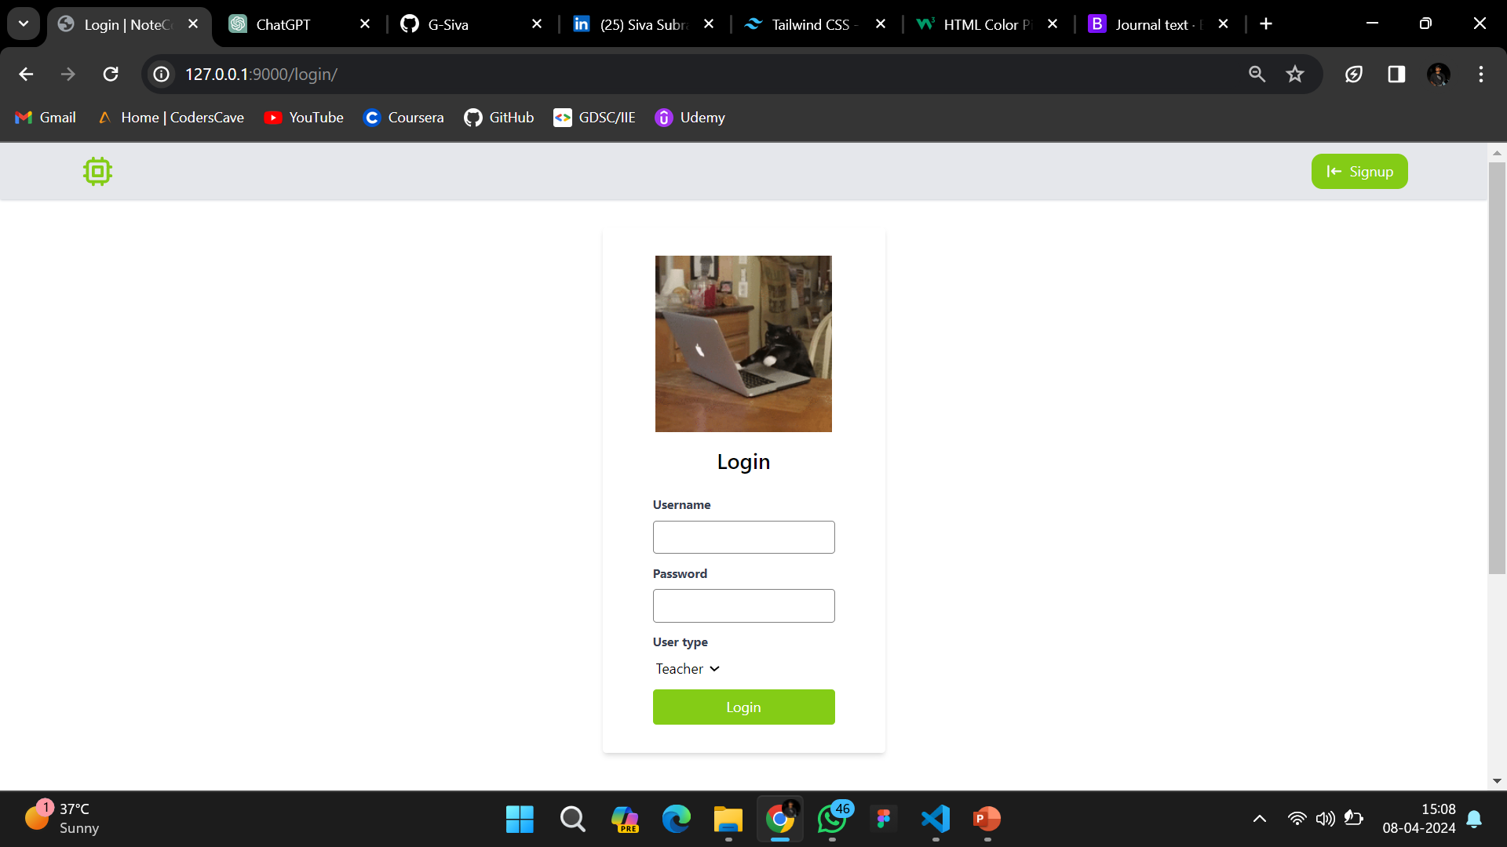
Login-Page

Slide 13
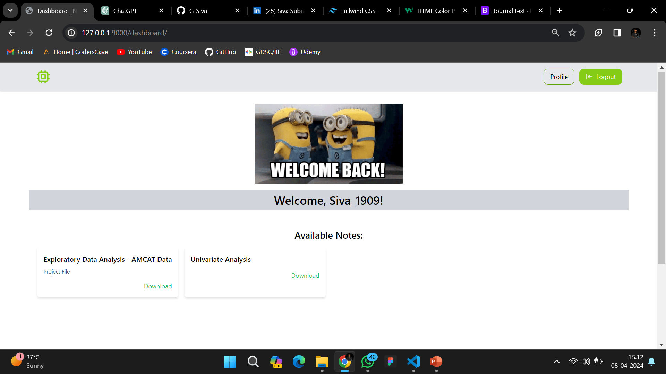
Dashboard-Page

Slide 14
Future Enhancements:
In future iterations of our notes sharing application built on the Django framework, we envision implementing advanced AI-driven features to enhance user experience and productivity. This includes the integration of natural language processing (NLP) algorithms for intelligent note summarization and keyword extraction, enabling users to quickly grasp the key points of lengthy documents and locate relevant information with ease. Additionally, we plan to incorporate machine learning models for sentiment analysis, allowing users to gauge the emotional tone of shared notes and provide actionable insights for improved collaboration and communication. Furthermore, we aim to introduce voice-to-text functionality for hands-free note-taking and transcription, catering to users who prefer spoken input methods. These enhancements align with our commitment to leveraging cutting-edge technologies to continually enhance the functionality and usability of our notes sharing application, ensuring it remains at the forefront of innovation in the collaborative productivity space.

Slide 15
Conclusion
In conclusion, the development of our notes sharing application using the Django framework represents a significant step towards enhancing collaboration and knowledge sharing among users. Through meticulous design and implementation, we have created a platform that offers robust features such as secure user authentication, real-time collaborative editing, version control, and granular sharing permissions.
Source :

Slide 16
Thank You!
Notes:
Thank You !!

